Slide 1
DEVELOPMENT OF EMBEDDED SYSTEM FOR ATM SECURITY USING GSM AND MEMS
Project guide: Batch no:13
Dr.J.Madhavan M.Lavanya (14321A0451)
A.Archana (15325A0401)
K.Soumya (15325A0406)

Slide 2
CONTENTS
Introduction
Block diagram
Components
Software required
Flow chart
Result
Advantages
Disadvantages
Applications
Conclusion
Future scope

Slide 3
INTRODUCTION
The aim of the project is to design a security system to access the ATM machine and is to provide a high level security system to ATM from being thefts and to give the access control of ATM to the authorized persons only.
For providing security at ATMs GSM & MEMS module are controlled by using ARMprocessor based LPC2103 microcontroller.

Slide 4
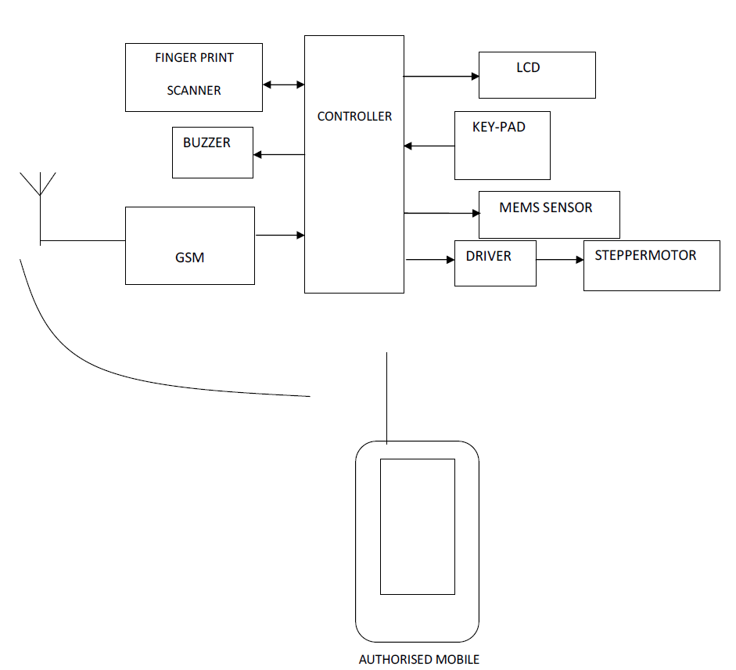
Block diagram

Slide 5
COMPONENTS
ARM 7 CONTROLLER
POWER SUPPLY
MEMS
LCD DISPLAY
GSM
FINGER PRINT SENSOR

Slide 6
ARM
ARM-Advanced RISC Machine
Microcontroller is the heart of the system. it is used for interfacing the display ,memory and other peripherals with GSM modem.
Microcontroller used especially in portable devices due low power consumption and its high permormance.
ARMLPC2103 microcontroller monitor MEMS module

Slide 7
FEATURES OF LPC2103
Operating speed upto 58.9624MHz
Direct in –circuit programming for easy program updates
Upto 32 I/O pins
Two RS232 connections with MAX232
8 channel 10-A/D
32 bit RISC microcontroller

Slide 8
MEMS
MEMS=Micro-Electro-Mechanical system
In this project ARMLPC2103 communicates with LCD, GSM modem. MEMS module is placed at cash locker block if any force is applied to this block MEMS sends the signal to LPC2103.
As the signal is received it locks the ATM center’s door through motor and alert message is sent to security using GSM module.

Slide 9
GSM Modem
GSM Modem can accept any GSM network operator SIM card and act just like a mobile phone with its own unique phone number.
The modem can either be connected to PC serial port directly or to any microcontroller. It can be used to send and receive SMS or make/receive voice calls.
GSM modem is a highly flexible plug

Slide 10
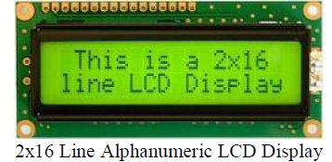
LCD
To display interactive messages we are using LCD Module.

Slide 11
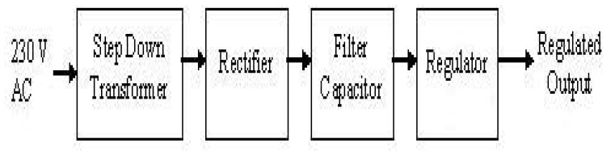
Power supply
The basic function of a power supply is to convert 230vac to 12vdc .

Slide 12
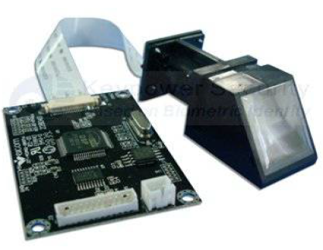
FINGER PRINT SENSOR MODULE
KY-M6 Fingerprint module adopts optic fingerprint sensor, which consists of high-performance DSP.

Slide 13
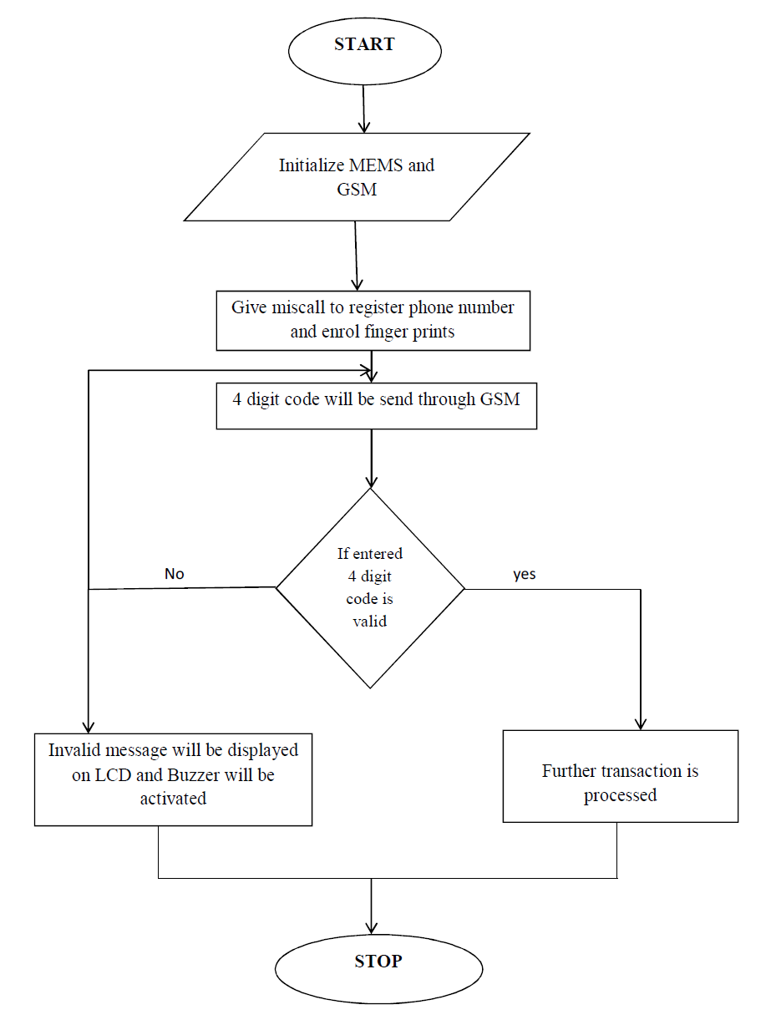

Slide 14
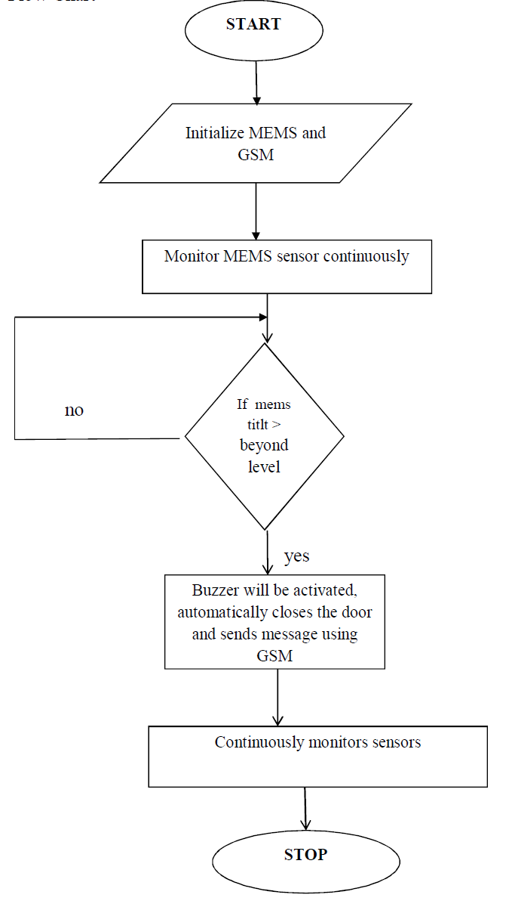

Slide 15
SOFTWARE TOOLS
KEIL µV-3(MICRO VISION)
FLASH MAGIC

Slide 16
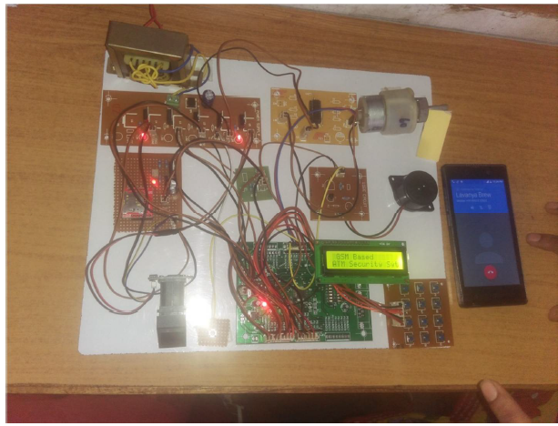
RESULT

Slide 17
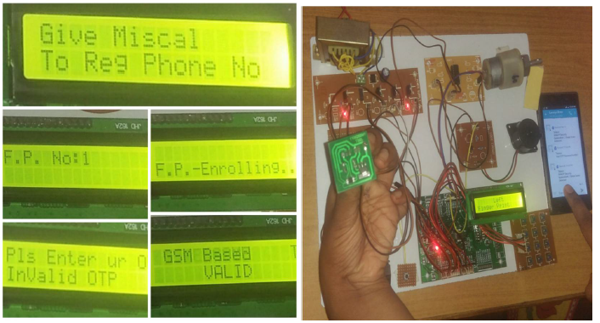


Slide 18
ADVANTAGES
security is high
need not remember any password
need not to carry any card
Theft identification
Remote monitoring system
Automatically get sms from the ATM.

Slide 19
Disadvantages
In case of cuts on finger the finger print module doesn’t accept the authorized person’s identification.
Even it doesn’t access if the dust particles are present on finger.
The mobile should be in appropriate network coverage area.

Slide 20
APPLICATIONS
Mainly used for ATM Security
Home appliances
Bank applications
Medical applications
Industrial applications
Automobile applications

Slide 21
CONCLUSION
The project “implementation of ATM security using MEMS and GSM ” has been successfully designed and tested.
Finally we conclude our topic saying that security is the most important thing to keep confidential matters secret.

Slide 22
FUTURE SCOPE
This circuit can be modified to work from a computer network. This facility once given, will help the users to control the home appliances from any Computer network such as internet.

Slide 23
Thank you

